Slide 1
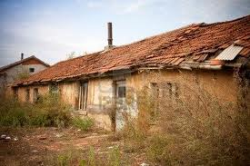

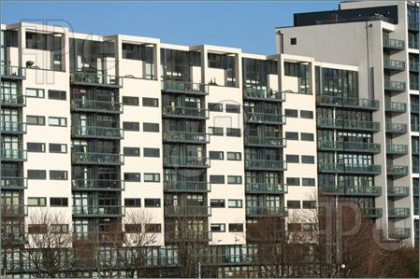
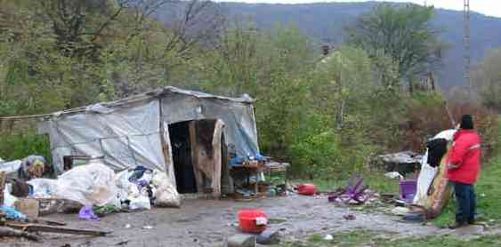
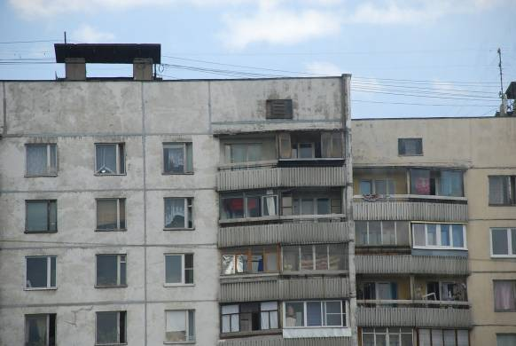
UNECE
Country Profiles on Housing and Land Management

Slide 2
UNECE Country Profiles – a tool to the Governments
CPs provide up-to-date analysis and country-specific recommendations as guidance to national governments on the reform of housing, urban development and land management sectors;
International organizations use CPs in preparation of their strategies and programmes;
CPs allow comparing the progress of implementation of the policies internationally.

Slide 3
UNECE Country Profiles
The Country Profiles on the housing sector were prepared and published for 16 countries, including Bulgaria (1996), Poland (1998), Slovakia (1999), Lithuania (2000), Romania (2001), the Republic of Moldova (2002), Albania (2002), Armenia and the Russian Federation (2004), Serbia and Montenegro (2006), Georgia (2007), Belarus (2008), Kyrgyzstan (2010), Azerbaijan (2010) and Tajikistan (2011), Ukraine (2013), Moldova (2013 – 2014), Uzbekistan (2014-2015)
Planned Russian Federation, Croatia

Slide 4
Profiles structure
the socio-economic and policy framework within which the housing sector is placed;
the institutional and legal framework;
the existing housing stock and new construction;
utilities;
the financial framework;
spatial/urban planning;
land administration.

Slide 5
UNECE Country Profiles – contributors and funding
Collaborative work:
In-kind contribution by the recipient country – in-country coordination, local experts, collection of data;
UNECE input: overall coordination, expertise, translation, editing and publishing costs,
UNECE member states/Committee members (Germany, for instance, for Ukraine) provide in-kind international experts to work on the profiles and conduct trainings
Donor support for UNECE Secretariat travel and international experts

Slide 6
Country profiles methodology review
Regular analysis of the Country Profiles (CPs) methodology to ensure the CP recommendations usability and higher political commitment by the governments to the recommendations’ implementation
The 2012 review will include development of guidelines for inclusion into the CPs the following dimensions:
Green Economy
Gender
Disaster Risk Reduction

Slide 7
Country profiles follow up
Monitoring of implementation of policy recommendations annually at the Committee sessions.
Establishment of high-level national intersectoral Habitat Steering Committees to implement CP recommendations
Development and partial implementation of National Action Plans to implement CP recommendations

Slide 8
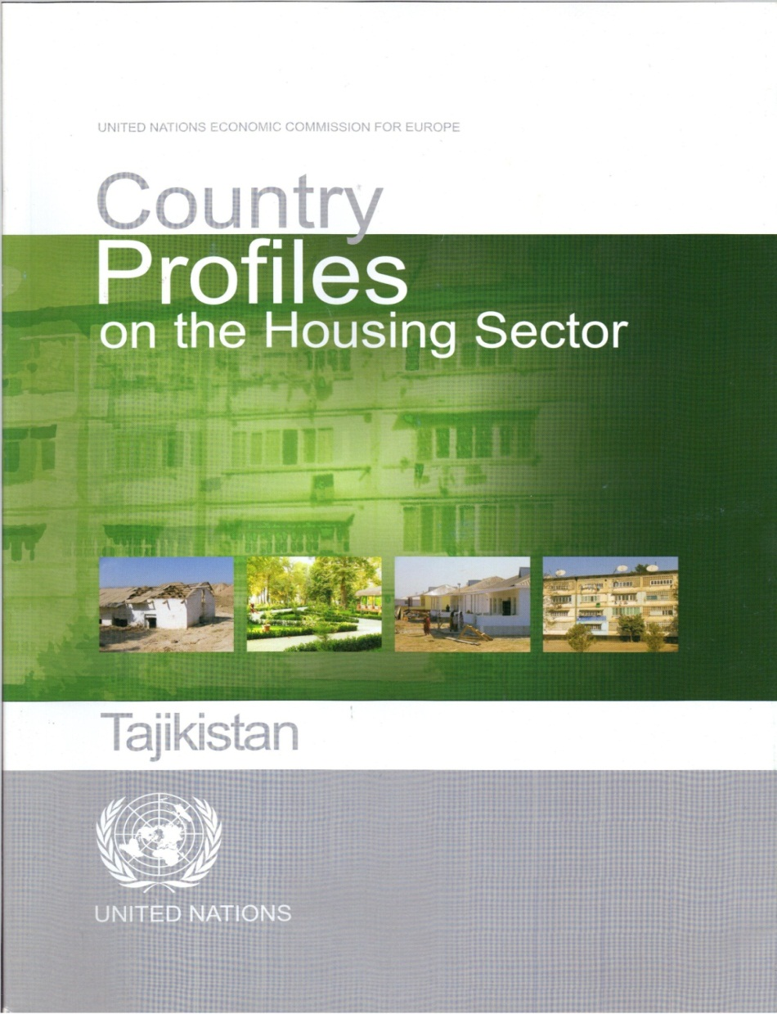
Tajikistan CP
Published in 2012
Launch event 13 – 17 May 2013
Elaborated National Action Plan

Slide 9
Tajikistan CP
Developed and adopted a new Urban Code of the Republic of Tajikistan
Drafted Government Decree "On Approval of the Concept of energy efficiency in housing and communal services in the Republic of Tajikistan until 2020 year." After receiving the instructions of the Government under the base of this document, is preparing Program of energy efficiency of the housing sphere
Streamlined procedures for administrative tasks associated with the construction activities in Tajikistan. One of the principles of this order is - the principle of one-stop shop.

Slide 10
Tajikistan policy priorities
Achieving consistent regularization of the roles and functions of central and local executive power bodies and local authorities;
Ensuring an effective investment policy in the housing sector;
Creating conditions for support for homeowners;
Develop measures to decrease construction costs
Funding for water supply and sewerage system rehabilitation

Slide 11
Tajikistan policy priorities
Rehabilitation of the district heating system as well as energy efficiency and renewable energy technologies should be promoted
The mortgage legislation should be improved and the prerequisites for viable capital markets should be created
The green spaces in cities should be preserved and further developed
The development of one-stop-shop principle in land administration

